Slide 1












Slide 2
State of the art model for 3d Object tracking

Slide 3
Method Overview
The method aims to recover pixel-wise 3D trajectories of scene points across video frames.
The total motion is decomposed into:
  Ego Motion – movement caused by the camera.
  Object Motion – movement of dynamic objects in the scene.

Slide 4
1. Ego Motion Estimation
Uses a temporal depth network (based on DepthAnything + DPT) to predict scale-aligned video depth.
A differentiable camera tracker estimates camera poses (rotation, translation, scale, and shift).
These parameters generate the initial ego-motion 3D tracks.
2. Joint Motion Optimization
A transformer-based module called SyncFormer jointly refines:
  2D and 3D trajectories,
  Dynamic probabilities (p_{dyn}) and visibility (p_{vis}),
  Camera poses.
Separate 2D and 3D branches interact via cross-attention, ensuring synchronized updates.

Slide 5
3. Camera Pose Refinement
After each iteration, trajectories and poses are aligned using:
  Weighted Procrustes analysis for coarse alignment.
  Differentiable bundle adjustment to refine camera poses.
The loop iteratively improves consistency between 2D projections and 3D motion.

Slide 6

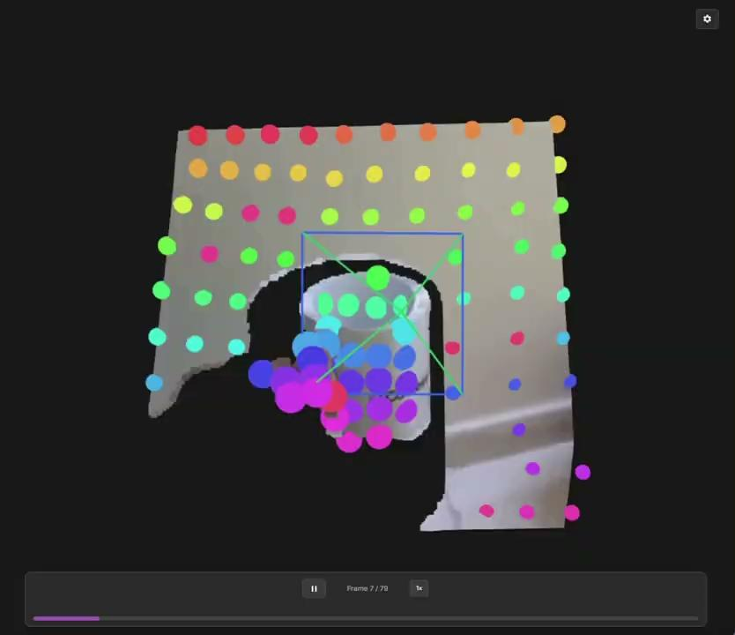

Slide 7
Why the Method Fails for Missing Objects or Frames
The method relies on continuous temporal correlations between consecutive frames to track objects in 3D.
When an object is missing or occluded, its visual and positional features are absent, breaking these correlations.
Without consistent frame-to-frame features, SyncFormer cannot propagate motion information, leading to trajectory gaps or incorrect 3D motion.
The missing data also disrupts the bundle adjustment, since it requires consistent 2D–3D correspondences across all frames for accurate camera pose refinement.

Slide 8
Context-Guided Inference for Missing Frame generation
To provide a temporal context guidance during missing frame generation (inference time) so the generated object motion x for a missing frame t is consistent with adjacent real frames (e.g. I_{t-1} ,I_{t+1})

Slide 9
Notation (Consistent with MotionModes)
• y – Input image (the frame that has a missing object or needs motion).
• m – Binary object mask (1 inside the object, 0 elsewhere).
• x ∈ ℝ^(F×H×W×2) – Motion vector field representing per-frame 2D offsets.
• xₜ – Noisy motion at diffusion step t; x₀ is the denoised motion.
• ϵₜ(·) – Pretrained motion denoiser (from MotionModes).
• Iₜ₋₁, Iₜ₊₁ – Context frames (actual neighboring frames from the video).
• W(I, x) – Differentiable warp operator that warps an image I by motion field x (implemented using bilinear sampling).
• F(·) – Frozen feature extractor (e.g., mid-layer activation from pretrained ViT/DINO, or VGG conv feature map).
• E(·) – MotionModes’ original combined energy (static camera, object motion, diversity, smoothness).

Slide 10
Context Guidance Energy — Definition
A simple and effective formulation requires that warping the previous real frame Iₜ₋₁ by the generated motion approximates the next real frame Iₜ₊₁ in feature space:
where
• Nₘ = Σ₍ᵢ,ⱼ₎ mᵢⱼ normalizes over object pixels (the mask can also be applied directly to the features if needed).

Slide 11

Follow MotionModes denoising but replace the denoiser input with a guided correction:
Compute the predicted noise-free motion at step t :
Apply gradient guidance using the total energy:
Here is a small step size (often called guidance strength or gradient step).
Proceed with the standard conditioned denoising update using :

Slide 12
MotionI2V

Slide 13
Motion due to camera
Motion due to jitter

